Slide 1
Where the odor code is built
LAB MEETING · FIGURE 7 AND THE APL-SILENCING DATA
Between the antennal lobe and the mushroom body output the fly turns “these two smells are alike” into “these are different”. Figure 7 says at which step and when. Yang Zheng’s APL-silencing recordings say what inhibition does to it.
Remy Yang · Caltech · October 2026
17 odors · 136 odor pairs · PN boutons n = 5 flies · KC claws n = 4 flies · KC somata with APL intact vs silenced (Yang Zheng)
Every section opens with the question a skeptic would ask. The appendix takes the objections one per slide; it is optional.
Where the odor code is built · 1
Section 1 of 9 · The point
Notes:
Opening line to say out loud: this talk starts from “what is the point”, because that is the right question. The data are in Figure 7 of the manuscript; the APL recordings are Yang Zheng’s and are not in the paper. Nothing here is a new analysis since the freeze; this is the same work explained from the beginning.

Slide 2

Where does the fly turn “alike” into “different”?
“Why does anyone care where this happens?”
ORN input
PN boutons
KC claws
KC somata
Similar odors arrive overlapping: an acetate and an ester drive many of the same channels (similarity ≈ 0.43).
The projection neurons’ terminals in the calyx: the input the Kenyon cells see. Still overlapping (≈ 0.45).
Each Kenyon cell’s dendrite samples about six boutons. Is the separation made here, by wiring, before any spike?
The spike output. The acetate–ester overlap is gone here (≈ 0.07). Threshold? Inhibition? Both?
If the separation is made at the dendrites it is wiring. If it is made at the spike output it is a threshold or inhibition. Different claims, different experiments.
Sections 3–6 test the bouton → claw step with the Figure 7 time series. Sections 7–8 test the claw → soma step with one fly imaged at both, and with APL silenced.
Where the odor code is built · 2
Section 1 of 9 · The point
Notes:
The point in one sentence: the mushroom body output separates similar odors, and we did not know which step does it. Figure 6 measured each stage once; Figure 7 measured the two calyx stages at every frame and tested the step directly. The acetate–ester numbers: ORN input and boutons 0.43–0.45, claws 0.44, somata 0.07 (APL deck, stages slide).

Slide 3
Figure 6 points at the bouton → claw step; by itself it cannot separate reorganization from noise or compression, or time it
“Didn’t Figure 6 already answer this?”
What Figure 6 has
What it cannot do
What Figure 7 adds
One similarity matrix per stage (every pair’s similarity, measured once). Correlations between consecutive stages: ORN → boutons 0.83, boutons → claws 0.80, claws → somata 0.84. The extra drop away from ORN (about 0.10) only just clears zero when the odors are resampled.
A correlation of 0.80 could be a real reorganization, or noise, or plain compression (every similarity shrunk by the same factor). It has no direction and no time axis.
The same matrices at every frame of the response (0.2–0.25 s). A direct test of the step: is the claw matrix more than a compressed, noisy copy of the bouton matrix? Which pairs move, and when.
Figure 6 is the motivation. Figure 7 is the test.
Where the odor code is built · 3
Section 1 of 9 · The point
Notes:
Figure 6 numbers from the manuscript framing (review deck, question slide notes). The point to make: a step correlation of 0.80 is consistent with “nothing interesting happened”, so a stronger test was needed before claiming the calyx does anything.

Slide 4
Two possible answers, two different mechanisms, two different predictions for APL
“What would change depending on the answer?”
If the separation is made at the claws
If it is made at the somata
It is built by which boutons each KC samples and how the dendrite adds them up. It exists before any spike. Silencing the inhibitory neuron APL should leave that part alone.
It is made at the readout: a spike threshold, or inhibition that raises the effective threshold. Silencing APL should undo some of it.
What we found, in one line. Part of the code is already in place at the claws and shows no detectable APL effect; the acetate–ester separation is made at the readout, and about half of that step needs APL (this second clause rests on one fly and on Yang Zheng’s silencing data, both exploratory). The rest of the talk is the evidence for each clause.
Where the odor code is built · 4
Section 1 of 9 · The point
Notes:
Preview of the answer so nobody waits 40 minutes for it. Each clause maps to a section: claw-specific pattern (Result 1), stable from the first frame (Result 2), odor vs pair shifts (Result 3), what it tracks (Result 4), same fly (section 7), APL (section 8).

Slide 5
Whether the separation at the readout is a spike threshold or inhibition
“What can the APL experiment decide that imaging cannot?”
Imaging cannot
Silencing APL can
Three separate targets
At 4 Hz, a threshold and a fast inhibitory input look identical: both make weak responses disappear between claws and somata.
APL is the one GABAergic neuron that feeds back onto all Kenyon cells. Remove it and whatever it was doing to the code is undone; whatever a threshold does stays.
Figure 7 had split the claw-to-soma change into three separate quantities, so the silencing effect has three distinct places to land instead of one blurred one.
Data: Yang Zheng. KC somata imaged with APL intact (TNT3c) and silenced (TNT), 12 of our 17 odors.
Where the odor code is built · 5
Section 1 of 9 · The point
Notes:
Without the Figure 7 split the comparison would have been “similarity goes up without APL”, which the field already expected. With it, the effect lands on one quantity and not on the other two, which is a specific claim.

Slide 6
Nine short sections, then an appendix you can skip
OUTLINE
1
The point: what the question is and why anyone should care
slides 1–6
2
What we measured, in pictures
slides 7–10
3
Result 1: the claw pattern is not just the bouton pattern
slides 11–15
4
Result 2: when the structure appears
slides 16–17
5
Result 3: odor shifts and pair shifts
slides 18–20
6
Result 4: what the claw-specific pattern tracks
slides 21–23
7
One fly, claws and somata on the same trials (exploratory)
slides 24–25
8
The APL silencing data (Yang Zheng) and what they decided
slides 26–31
9
So what: the claim, the next experiments, where the work lives
slides 32–34
A
Appendix: objections and how each one was handled; the math
slides 35–49
Where the odor code is built · 6
Section 1 of 9 · The point
Notes:
The bar at the bottom has one segment per section: completed sections pale blue, the current one filling up, upcoming grey. The appendix is the last segment.

Slide 7
Calcium in two layers of the calyx, 17 odors, every quarter second
“What did you actually measure?”
 | PN boutons | KC claws
What | projection-neuron terminals (input to the calyx) | Kenyon-cell dendrites (the claws around those terminals)
Flies | 5 | 4
Frame | 0.2 s | 0.25 s
Trials per odor | 3 | 3
Odor on | 0–3 s | 0–3 s
References from other flies
ORN input and KC somata matrices (static, one per stage), plus two wiring models from Figure 6: random PN → KC wiring (“uniform”) and connectome-weighted wiring (“hemibrain”).
The limitation to say first
Boutons and claws come from different animals. Every reproducibility test therefore splits the flies into halves and asks whether the halves agree.
Where the odor code is built · 7
Section 2 of 9 · What we measured
Notes:
Variables: F_zscore for boutons, Fc_zscore for claws. Bouton frames are interpolated onto the claw frame times before comparison. The manuscript’s PN terminals are n = 6; the time series have 5 (one acquisition dropped); Figure 7 reports n = 5.

Slide 8
One number per odor pair: do the two odors light up the same cells?
“What is a “similarity” number?”
Toy: ten cells, three odors. Bar height = response of each cell.
The number is Pearson r
odor A
odor B
odor C
Each odor’s response across the cells is a list of numbers. r asks whether two lists go up and down together. It ignores how big the responses are and any offset shared by all cells.
A and B rise and fall together across the cells: similarity ≈ +0.9. A and C are mirror images: similarity ≈ −0.9. Unrelated patterns give ≈ 0.
Why that one
It is the quantity the hypothesis is about (which odors share cells), it is what Figure 6 used, and it keeps claws and boutons in the same units, so a slope between them is a compression factor.
Where the odor code is built · 8
Section 2 of 9 · What we measured
Notes:
This is the only definition the audience needs for the next 30 minutes. “Similarity” on every later slide means this r. The one thing r hides, amplitude, comes back as an explicit caveat in the appendix.

Slide 9
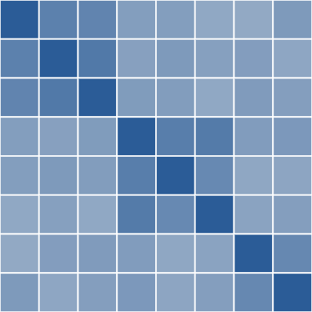
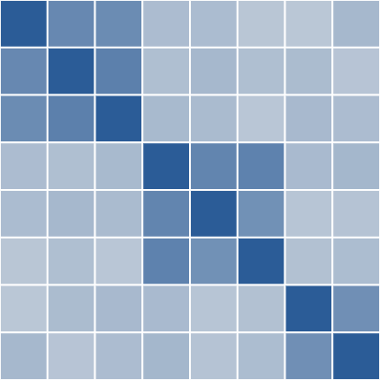
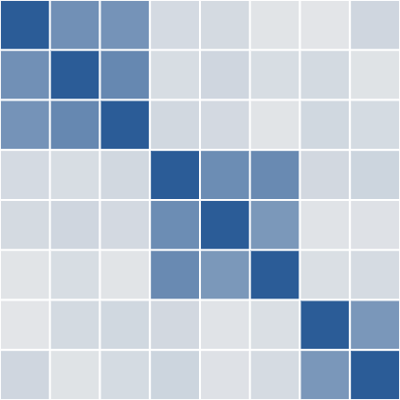

All 136 pair similarities at once, recomputed at every frame
“Why a matrix, and why a movie of matrices?”
What a matrix shows
Blocks of dark cells are odor groups. A row that is dark everywhere is an odor similar to all the others.
What the movie adds
Toy: eight odors in three groups, three frames of one response. Dark = similar. Here the groups are there from the start and the background similarity fades: the level changes, the shape does not. The real matrix is 17 × 17 (136 pairs), one per frame, per fly, per layer.
Whether the blocks exist at the first reliable frame or appear during the odor; whether the matrix changes its shape or only its level.
How two layers are compared
Pair by pair: each pair’s claw similarity against the same pair’s bouton similarity at the same time.
Where the odor code is built · 9
Section 2 of 9 · What we measured
Notes:
The real matrices are in the decomposition dashboard for any time bin. Frames before 0.5 s in claws and after about 6 s in both layers are not reliable (split-half below 0.5) and are not interpreted.

Slide 10
Six names used on every slide from here on
TERMS, IN PLAIN WORDS
Term | What it means
similarity | Pearson r between two odors’ response patterns at one frame: do they light up the same cells?
z units (SD) | the 136 pair values standardized: 0 = average pair, 1 = one standard deviation above
claws beyond E[claws | boutons] | the part of claw similarity that boutons do not predict: the vertical distance from the fitted line
odor part | one number per odor: how much that odor became more (or less) similar to everything
pair part | what is left after the odor parts: a change specific to that pair of odors
split-half | the same number computed from two disjoint groups of flies; agreement between the halves is the reliability
Where the odor code is built · 10
Section 2 of 9 · What we measured
Notes:
The residual naming (“Y beyond E[Y | X]”) is deliberate: a plain difference between two layers also carries regression to the mean, a residual does not. “Noise-corrected” on later slides means divided by the split-half reliability so noise is not counted as change.

Slide 11
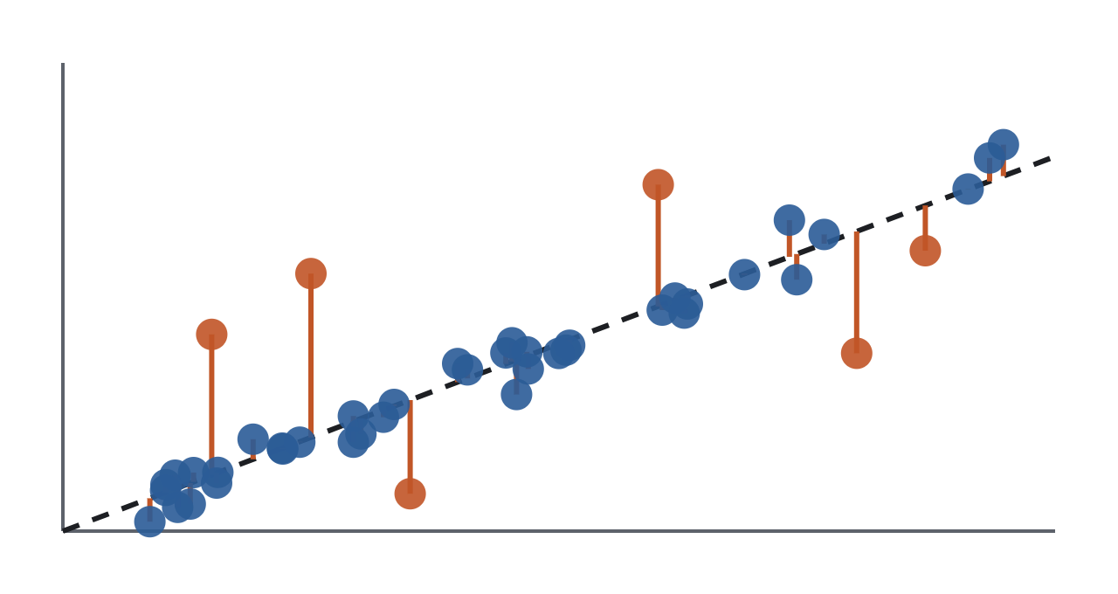
Mostly, yes: claws are a compressed copy of boutons. The result is in the exceptions.
“Isn’t the claw matrix just the bouton matrix again?”
Above the line
The pair is more similar in claws than boutons predict. Something at the claws brought these two odors together.
claw
Below the line
Less similar than predicted: something pushed them apart.
bouton similarity of the pair
Schematic, not data. One dot per odor pair at one frame. The dashed line is the fit: slope ≈ 0.80, so claws compress bouton similarity. The vertical distance from the line is what the next 20 slides are about.
The name for the distance
“Claws beyond E[claws | boutons]”: the part of claw similarity that boutons do not explain. Computed on z-scored values across the 136 pairs.
Where the odor code is built · 11
Section 3 of 9 · Result 1 · real?
Notes:
Why a linear fit: slope = compression, residual in interpretable units. The relation is slightly convex (quadratic F 27.8, p < 0.001; cubic ns), the signature of a sparsening nonlinearity; a quadratic fit lowers the headline numbers by at most 0.12 and keeps 7 of the 11 top movers (appendix). The 0.80 is from fly-mean matrices; from single trials it is 0.77 observed and 0.85 after correcting for noise (appendix, disattenuation).

Slide 12
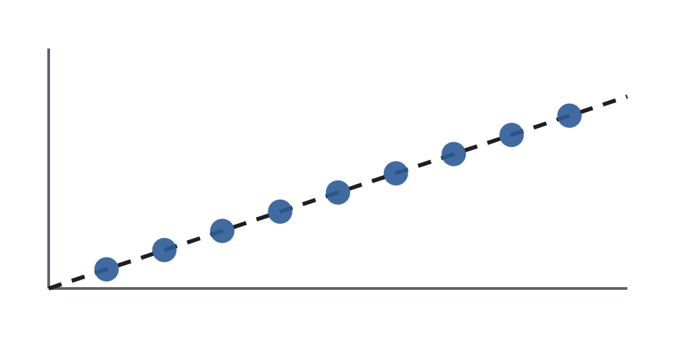
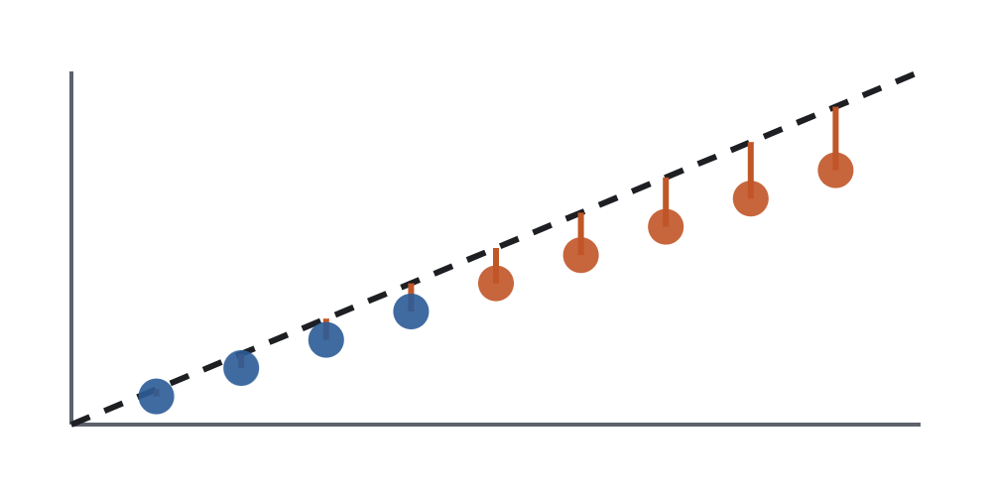
“Claws minus boutons” would call every strong pair a loser; the fit removes the compression first
“Why not just subtract the two matrices?”
Subtract. Toy: nine pairs that sit exactly on the compression line. Dashed: claws = boutons. Claws − boutons is negative for every strong pair and near zero for weak ones, purely because of the 0.8 slope. It would look as if strong pairs weakened.
Fit, then look at the leftovers. The same nine pairs against their own fitted line: every leftover is zero. Nothing happened beyond compression, which is the right answer for this toy.
claw
claw
bouton similarity
bouton similarity
The real test: are the leftovers (a) not zero, (b) the same in independent flies, (c) organized? Plain differences are used only where the difference itself is the question (the claws → somata change).
Where the odor code is built · 12
Section 3 of 9 · Result 1 · real?
Notes:
In the toy the fitted line is the identity on the left panel so the residual lines show the plain difference. The methodological point: a difference between layers also carries regression to the mean, so it was named separately (“X→Y change”) and only used for the claws → somata step, where the change itself is the quantity of interest.

Slide 13

The same leftover pattern appears in flies that were never compared with each other
“Couldn’t the leftovers be noise?”
Split-half. Split the bouton flies into two groups and the claw flies into two groups. Compute the leftover pattern from group A of each, and separately from group B. Correlate the two patterns across the 136 pairs.
r 0.56–0.60, every window
The leftover pattern replicates across fly halves in every odor window from 0.5 to 3 s. The plain bouton − claw difference replicates too (r 0.49; p ≤ 0.0005 by shuffling odor labels, appendix A1).
half A
leftover pattern A
leftover pattern B
half B
r = 0.57
Single pairs: no power
0 of 136 pairs pass a per-pair test after correcting for 136 tests (5 vs 4 flies). The claim is about the pattern, never about one pair.
Blue dots = bouton flies (5), teal = claw flies (4). 30 different splits, averaged. Noise would give r ≈ 0.
Where the odor code is built · 13
Section 3 of 9 · Result 1 · real?
Notes:
The pattern is not organized by chemical class (p 0.45). Plain difference also replicates (r 0.49). Why odor-label permutation everywhere: each odor sits in 16 of the 136 pairs, so the pairs are not independent; shuffling odor labels keeps that dependence and breaks only the match. Effective n is about 65 pairs, not 136. Fisher-z and rank versions change nothing.

Slide 14
Holding boutons fixed, the claw leftovers look like the KC somata, not like the sensory input
“Fine, it is real. What is it?”
claws ~ boutons + reference | coefficient | p
KC somata (spike output, other flies) | +0.48 | 0.0001
Hemibrain-wiring model | +0.30 | 0.003
Uniform-wiring model | +0.09 | 0.58
ORN input | −0.08 | n.s.
Somata + hemibrain together | +0.42 / +0.13 | 0.0002 / 0.16
Read it as
Which stored matrix best explains the part of the claw matrix that boutons do not? The somata win, the input loses. The coefficient is in z units: +0.48 SD of claw similarity per SD of somata similarity.
Already there at 0.5 s
The somata-like component is +0.51 at 0.5–1 s and flat through the odor. And the somata inherit it: predicting somata from boutons and claws, claws carry the weight (+0.81 vs +0.13).
Where the odor code is built · 14
Section 3 of 9 · Result 1 · real?
Notes:
Split-fly instrumental variable (next slide for why), 0.5–3 s, z-scored pair vectors; jackknife SE ≈ 0.15 for somata; leave-one-odor-out range 0.34–0.52. References are static matrices from other flies (orn_remy; kc_remy_combo; uniform_tom; hemibrain_wd20_tom). Chemistry (ECFP) and natural-source distances have coefficients at zero in the same model. With the 4-fly somata reference the coefficient is 0.40; no conclusion changes.

Slide 15

Yes, and that is why boutons were predicted from other flies first
“You regressed one noisy thing on another noisy thing.”
claws ~ predicted boutons + reference
The trap. Bouton similarity is measured with noise. A fit on the noisy bouton matrix cannot remove the bouton structure the noise hides, so any reference that resembles boutons gets credit for it. ORN input would look “explanatory” for no reason.
boutons, half A
predicts boutons, half B
2 flies
3 flies
The fix. Half A of the bouton flies predicts half B. Only bouton structure that reproduces across flies survives. Fit claws to that cleaned prediction plus the reference; 10 splits × 2 roles = 20 fits, averaged.
Checked on a simulation
Claws built to copy boutons exactly, plus a reference with no true effect: plain regression credits the reference as bouton noise grows; the split-fly version stays at zero.
The limit
Two or three flies per half, 136 non-independent pairs, a noisy reference. The first stage is strong (bouton split-half r 0.72–0.84), but this is the step a statistician should look at hardest.
Where the odor code is built · 15
Section 3 of 9 · Result 1 · real?
Notes:
Exactly identified 2SLS. p from odor-label permutation (Freedman–Lane: residuals of the reduced model permuted by odor label, same permutations for every split, 1,000–10,000 permutations); SE from a leave-one-odor-out jackknife. Somata tests instrument both boutons and claws by fly halves. Ranks and a quadratic term change the somata coefficient by 0.1 or less (+0.45, +0.38). The simulation is explainer tab 3.3.

Slide 16
Somata-like by the second reliable frame, and the same shape for the next 2.5 seconds
“Does this build up during the sniff, or is it there from the start?”
rank correlation with somata minus rank correlation with ORN | 0.5–0.75 s | 2–3 s
KC claws | +0.11 → +0.15 | +0.07 to +0.09
PN boutons | −0.07 (at 0.6 s) | −0.20
Stable shape, in numbers
Stability of the claw-specific pattern across odor windows, after dividing out the noise (appendix A2): 0.91–0.98, where 1 means no change. Nothing re-sorts over seconds.
Figure 6’s statistic at every frame: how well each layer’s matrix matches the stored ORN and somata matrices. Claws sit on the somata side at every reliable frame from 0.5 to 4 s. Boutons drift the other way, toward ORN (0.77 → 0.85).
Clusters too
Cut each fly’s claw matrix into groups: the 0.5 s frame is reliable but coarse (agreement with the somata groups 0.07); one frame later the somata groups are there (about 0.45) and stay to 2 s, in 4 of 4 flies. Agreement with ORN groups falls (3 of 4).
“Reliable frame”: split-half reliability above 0.5 (from 0.5 s in claws, until about 6 s in both layers).
Where the odor code is built · 16
Section 4 of 9 · Result 2 · when
Notes:
ρ somata − ρ ORN is jackknifed as one quantity (leave-one-fly-out) since the same flies enter both terms. Pearson and Spearman agree. Cluster check (Figure S7B): average linkage, k by silhouette, ARI vs ORN (k = 2) and somata (k = 6) clusters; the somata-side rise survives a within-fly trial bootstrap (P ≥ 0.94 per fly) and matched-k comparison; the ORN-side fall survives it in only one fly, and ARI rewards coarse partitions, so “ORN-like early” mostly means “coarse early”. Say that out loud before someone else does.

Slide 17
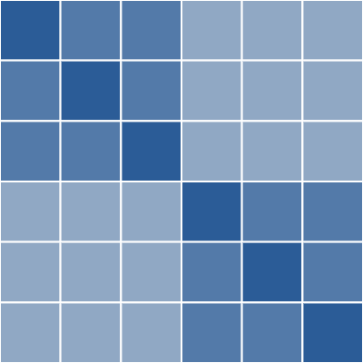
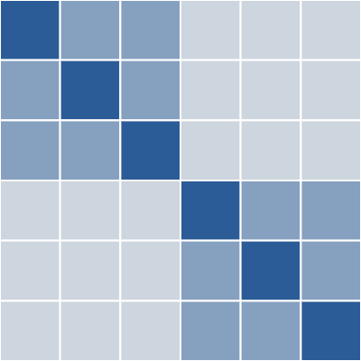
The level changes; the shape does not. A fast shared decorrelation, larger in claws
“But the similarities do change over the odor. You just said they don’t.”
Toy: level vs shape. Same two groups, every similarity lower in the second matrix. Which pairs are alike has not changed; how alike everything is has.
Real: between-odor similarity ÷ same-odor reliability (so a loss of signal does not count as decorrelation)
claws, first frame
0.46
claws, 1.5 s
0.27
claws, 3 s
0.22
boutons, first frame
0.38
boutons, 1.5 s
0.27
boutons, 3 s
0.26
A component shared by every odor at onset, fading with a time constant of about 0.5 s (0.52 s boutons, 0.66 s claws), gone by about 1 s. It changes the level of similarity, not which pairs are similar; claws lose about twice as much. It is not the claw-specific pattern of Result 1, which is present at 0.5 s and flat.
Where the odor code is built · 17
Section 4 of 9 · Result 2 · when
Notes:
Ratio computed per fly and averaged; first reliable frame 0.4 s (boutons) and 0.5 s (claws). Same-odor r, peak → 3 s: boutons 0.75 → 0.68, claws 0.72 → 0.56. The τ values are at the resolution limit of 0.2–0.25 s frames and the indicator; the report rounds both to ≈ 0.5 s. Rank geometry survives the decorrelation (previous slide).

Slide 18
Two different things can happen to a similarity matrix: an odor shift or a pair shift
“Which odors moved, and what does “moved” even mean?”
A
B
C
D
E
A
B
C
D
E
A
Odor shift
A
Pair shift
B
Odor C moves toward every other odor. Its whole row and column change together. One number per odor describes it: the odor part.
B
B and D become more alike, and nothing else changes. One cell and its mirror. That is the pair part.
C
C
D
D
E
E
In the data both happen at once. Fitting “pair leftover ≈ odor value i + odor value j” to all 136 pairs pulls out the odor part; what the fit cannot explain is the pair part. Orange = more similar in claws than boutons predict. Five-odor toy, not data.
Where the odor code is built · 18
Section 5 of 9 · Result 3 · odor vs pair shifts
Notes:
Population-vector reading: an odor shift is one odor’s response pattern moving toward or away from the average pattern of the whole panel (for example gaining a component every odor shares); a pair shift is two odors gaining claws that respond to both and little else. Appendix B gives the exact vector statement for anyone who wants it.

Slide 19
A pair part that is large, stable and somata-like, and an odor part that drifts
“And in the real matrix?”
Pair part · 60–67 % of the leftovers
Odor part · 32–40 % of the leftovers
Full size at 0.5 s and stable across odor windows (noise-corrected 0.91–0.98). Reproducible across fly halves (r ≈ 0.6, p 0.002). It matches the somata (r 0.65–0.71): odors in the same somata cluster are pulled together (+0.49 SD, p 0.0003).
One value per odor. It carries 62 % of the change from early to late in the odor; that change replicates across fly halves (r 0.46, p 0.001). Linalool fades (+0.78 → +0.40); acetic acid builds (+0.04 → +0.47).
Similarity created, not just kept
Not a timing artefact
Four of the six largest gains are pairs boutons keep near r ≈ 0.1 that claws bring to 0.24–0.38: 2h–Lin +1.71 SD, t2h–va +1.55, Lin–aa +1.51, IaA–pa +1.37. Nine of the ten top movers move the same way in the somata.
Best bouton lag during the odor ≤ 0; the change survives lag, low-pass, multi-lag, quadratic and rank controls (split-half r 0.34–0.50, all p 0.001).
Where the odor code is built · 19
Section 5 of 9 · Result 3 · odor vs pair shifts
Notes:
Residual z(claw r) − linear prediction from z(bouton r), per window, across the 136 pairs. Units: SD. Top losses: 1-6ol–B-cit −1.28, 1-5ol–va −1.06. Odor-specific timing (0.5–1 → 3.25–4.5 s): Lin +0.78 → +0.40; aa +0.04 → +0.47 by 2–3 s; t2h +0.19 → −0.59; B-cit −0.40 → −0.06. Temporal stability = cross-time split-half r ÷ geometric mean of the same-time split-half r’s.

Slide 20
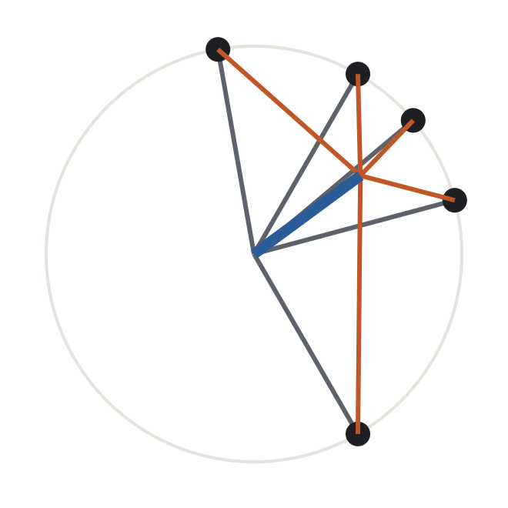
It is a real thing: each odor’s pattern is “the average pattern” plus “its own deviation”
“Is this “odor part / pair part” a real thing or a curve fit?”
Odor part = how far an odor leans toward the average
Grey: each odor’s response pattern, drawn as an arrow (five odors, flattened to a plane).
An odor whose arrow points along the blue one is similar to everything; the fit’s odor value is exactly that lean (up to one known scale factor).
Blue: the average pattern of the whole panel.
Rust: what each odor does beyond the average.
Pair part = what two odors share beyond the average
The overlap of two rust arrows. Rows of it sum to zero, so it cannot hide an odor-level effect.
Proof and numeric check: appendix B, two slides. Exact to 10⁻¹⁶ on a 17-odor toy.
Where the odor code is built · 20
Section 5 of 9 · Result 3 · odor vs pair shifts
Notes:
The identity: r_ij = |m|² + ⟨d_i,m⟩ + ⟨d_j,m⟩ + ⟨d_i,d_j⟩ with x̂_i the centred unit response vectors, m their mean, d_i = x̂_i − m. The fitted odor values equal (n/(n−2))·⟨d_i,m⟩ + constant exactly; the pair part equals ⟨d_i,d_j⟩ up to a small additive leak. The residual case (claws beyond boutons) inherits the same meaning because z-scoring and residualizing are affine. Caveat: the average pattern is the average of the 17 odors delivered, so the odor part is panel-relative; the jackknife covers that.

Slide 21
Partly. Either wiring model predicts some of the pair part; only the odor part carries what the connectome adds
“Does the wiring explain it? You have a connectome.”
claw leftovers vs … | 0.5–1 s | 1–2 s | 2–3 s
pair part vs hemibrain model | 0.29 | 0.32 | 0.37
pair part vs uniform (random) model | 0.23 | 0.26 | 0.31
pair part vs hemibrain − uniform | 0.14 n.s. | 0.14 n.s. | 0.14 n.s.
odor part vs hemibrain − uniform | 0.21 n.s. | 0.54 (p 0.02) | 0.62 (p 0.008)
What any expansion gives
The two models’ pair-part predictions overlap (r 0.58). The share they predict (r 0.23–0.37, against a reliability ceiling of ≈ 0.78, the most any predictor could reach) is what sampling six boutons per KC produces whatever the wiring. Most of the reliable pair part is predicted by neither.
What the connectome adds
Only in the odor part, and only during the sustained odor: 0.21 → 0.54 → 0.62, then 0.17 after offset. One ester × aldehyde block the connectome pushes apart is pushed apart in claws too (block mean −0.49 SD, p 0.009).
Both models are Figure 6’s: random PN → KC wiring (“uniform”) and connectome-weighted wiring (“hemibrain”). Each has the bouton prediction removed, like the claws, and is split into the same two parts.
Where the odor code is built · 21
Section 6 of 9 · Result 4 · what it tracks
Notes:
RE-CHECKED 2026-10-28 (two_slope_residual.py, per-fly data): boutons predict claws at slope ≈ 0.5 at the odor level but ≈ 0.95 at the pair level (leave-one-fly-out ranges do not overlap), so the residual’s odor part carries a leftover of about −0.3 × the bouton odor values, and the bouton odor values correlate −0.77 with the model difference. With a two-slope residual the match becomes r 0.18 (p 0.50) at 1–2 s and 0.27 (p 0.30) at 2–3 s (0.42, p 0.10 with the models two-sloped too). Pair part and drift are unaffected. If asked: say the odor-part link to the connectome is, after this check, at most a trend during the sustained odor, and that the wording is being revised. Added value for the claw leftovers: uniform model R² 0.05 → + (hemibrain − uniform) 0.16 (p 0.001), almost all at the odor level (odor values R² 0.02 → 0.46). Claws could follow the pair part of the model difference (ceiling ≈ 0.78; somata reach 0.69) but mostly do not (0.13–0.16). The specific links the connectome predicts go the wrong way (2-but–aa, 1-8ol–t2h negative in claws in every window). A static wiring model can still give a window-dependent match because the bias acts through whichever PNs are active, and that changes over the odor. The block was chosen from the model difference, not from claws; its permutation compares it with every block of two disjoint odor triples (123,760).

Slide 22
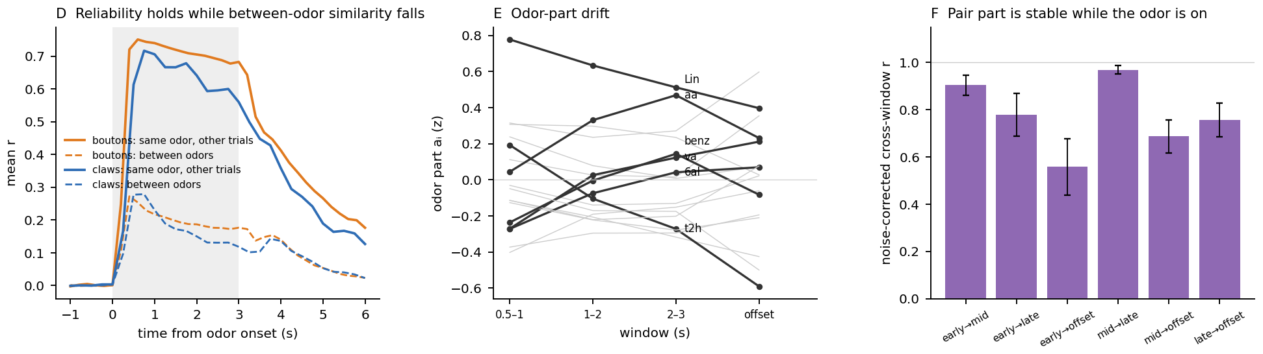
A slow change in how much each odor shares with the rest; it also shows up at the somata
“So what is the odor-part drift, if not wiring?”
What drifts
From the first second to after offset (0.5–1 → 3.25–4.5 s): linalool fades (+0.78 → +0.40), acetic acid builds (+0.04 → +0.47 by 2–3 s), t2h separates (+0.19 → −0.59). In the same fly, about 40 % of the drift reaches the somata (r 0.74).
Between-odor similarity falls while same-odor reliability holds (D), so the drift changes what odors share, not how reliably each is represented. The pair part (F) is flat.
Working hypothesis, untested
A slow per-odor gain on a component every odor shares. Not APL (the silencing data, section 8) and not a timing artefact (lag controls). Nothing downstream depends on the hypothesis.
Where the odor code is built · 22
Section 6 of 9 · Result 4 · what it tracks
Notes:
The drift and the odor part are different quantities: an odor can have a high odor part throughout without drifting (2h). That distinction is what lets the APL data tell “APL holds the odor part down” from “APL makes the drift”. The connectome bias shows up in the odor part during the sustained odor, so the odor part is where wiring and the slow gain both act; the drift itself does not follow the connectome (r +0.13 with the APL effect; model difference over windows 0.21 → 0.62 is the odor part, not its change).

Slide 23
Each question, the answer, and what it ruled out
FIGURE 7 IN ONE TABLE
Question | Answer | Ruled out
Do claws differ from boutons beyond compression and noise? | Yes: the extra pattern reproduces across fly halves (r 0.56–0.60) | Claws simply inherit boutons
What does the extra pattern track? | The KC somata: +0.48 (p 0.0001), +0.43 to +0.49 in every 0.5-s bin | Inherited input noise (ORN −0.08)
When does it appear? | From the first reliable frame (0.5 s), stable to 3 s (0.91–0.98) | Builds up during the odor
What changes over time? | A fast shared decorrelation (τ ≈ 0.5 s) and a slow odor-part drift | Pairs re-sorting over the odor
How does the pattern split? | Pair part 60–67 % (stable, somata-like, partly wiring); odor part 32–40 % (drifts, carries the connectome bias) | One undifferentiated change
Every row survives: no lag or low-pass explains it; attenuation corrected; holds on Fisher z, ranks and quadratic fits (within 0.07) and with the 4-fly somata reference.
Where the odor code is built · 23
Section 6 of 9 · Result 4 · what it tracks
Notes:
The whole analysis on one slide, in the order it was done. The findings-tree page has the files behind each step.

Slide 24
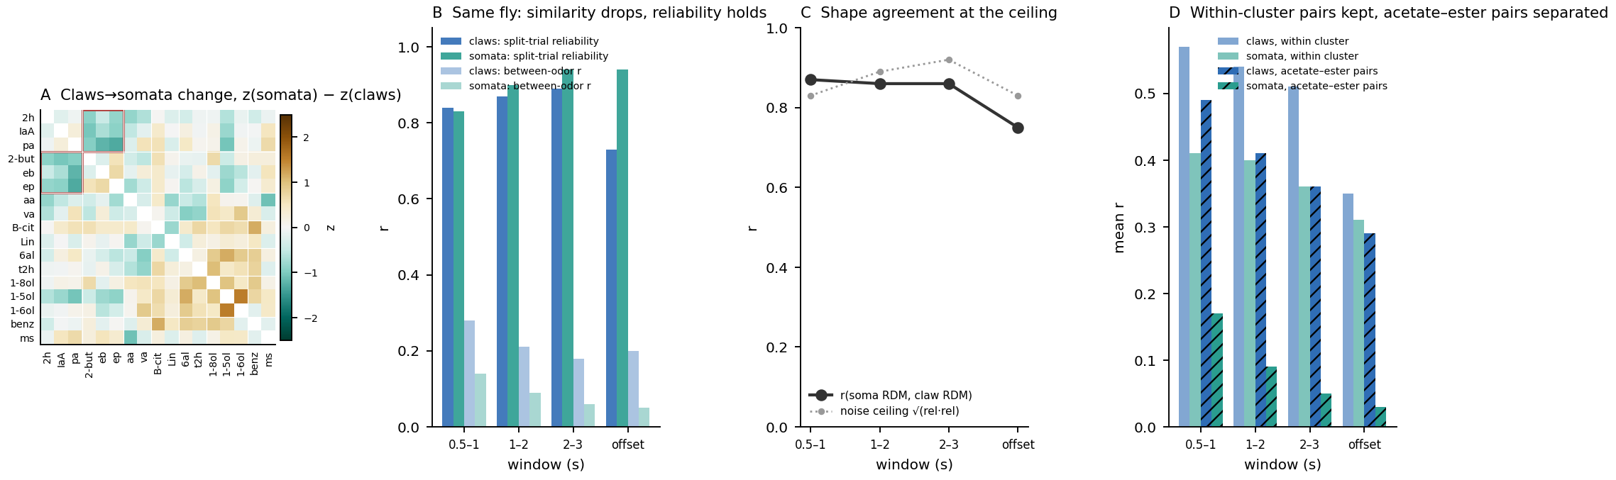
One fly, claws and somata on the same trials: same shape, sharper at the somata
“Boutons, claws and somata are from different flies. How do you know the step is real?”
Same shape: r 0.86
Sharper: +1.7 / −1.3 SD
Exploratory
Claw and soma matrices agree at the noise ceiling (0.83–0.92) in every window; the step does not change over the odor.
Within-cluster pairs pulled together, acetate × ester pairs pushed apart, beyond what claws predict. The 4-fly result inside one animal.
One fly, somatic calcium (not spikes), 4 Hz. Not part of Figure 7; shown because it answers this question.
Where the odor code is built · 24
Section 7 of 9 · Same fly · exploratory
Notes:
689 claw ROIs and 2035 somata ROIs on the same trials, 17 odors. Between-odor r settles at 0.17 in claws (τ 0.67 s) and 0.05 in somata (τ 1.0 s). After offset about 5 % of claws respond to every odor; the somata have no OFF cells and keep their shape (0.91). Discussion answers §9, §9d, §9e; outputs/results/10_soma_vs_calyx_same_fly/.

Slide 25
The weak responses go missing: a threshold signature
“What happens to single cells between claws and somata?”
shares of the acetate × ester r (1–2 s) | claws | somata
total r | 0.44 | 0.10
from cells silent to both | +0.31 | +0.13
from ester-selective cells | +0.05 | −0.04
Read it as
At the claws, ester-selective cells still give weak acetate responses that keep the two groups overlapping. At the somata those weak responses are gone: subtraction followed by a threshold.
Exact per-ROI decomposition of Pearson r into cell-type contributions.
Why it matters for APL
A threshold and a global inhibitory input that raises the effective threshold look identical here. Imaging cannot separate them; the next section’s silencing data can.
Where the odor code is built · 25
Section 7 of 9 · Same fly · exploratory
Notes:
Single-cell reading is from the same-fly recording only. The somata keep decorrelating after the claws plateau (0.17 vs 0.05), consistent with a threshold acting on a shared component. Exploratory.

Slide 26
Three predictions, one for each quantity Figure 7 had separated
“What exactly did the APL data test?”
1 · The pair part
2 · The claws → somata step
3 · Odor part, or its drift?
If APL built it, silencing should change the pairs with the largest pair part most. Figure 7 predicts no effect: it is set in the dendrite and stationary. A null result is the informative one.
If APL separates the acetate–ester pairs, silencing should hit them hardest, and they should return toward their claw similarity.
If APL makes the drift, the effect follows each odor’s drift. If APL holds the odor part down, it follows the odor part itself. The two differ per odor (2h: high odor part, no drift).
The three can be tested separately because across the 66 pairs the pair part and the part of the somata matrix that claws do not predict are only weakly correlated (r 0.20). Each test holds the other quantity constant.
Data: Yang Zheng · KC somata, APL intact (TNT3c) vs silenced (TNT) · 12 of our 17 odors, 66 pairs
Where the odor code is built · 26
Section 8 of 9 · APL data · Yang Zheng
Notes:
Prediction 1 is the labmate’s own question. Because the three quantities are nearly independent across pairs, partial correlations can hold one constant while testing another. Every p-value here is an odor-label permutation (10,000 relabelings), since the 66 pairs share odors.

Slide 27
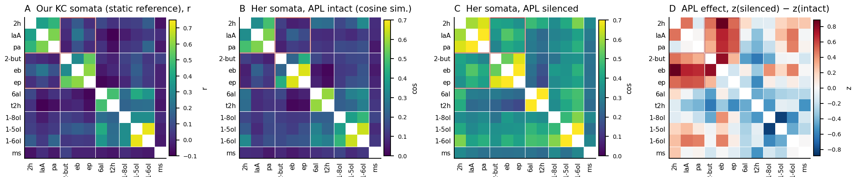
Yang’s APL-intact somata match our stored somata matrix at r 0.93; silencing raises every pair
“How do I know your somata and Yang’s are the same thing?”
A vs B: r 0.93
C and D: every pair rises
An independent replication of the somata matrix the argument rests on. Yang’s similarity is cosine, ours Pearson r; the pairs rank alike.
Without APL all pairs become more similar, the acetate–ester pairs (red box) most.
Data: Yang Zheng · KC somata, APL intact (TNT3c) vs silenced (TNT) · 12 of our 17 odors, 66 pairs
Where the odor code is built · 27
Section 8 of 9 · APL data · Yang Zheng
Notes:
Her matrices cover 12 of our 17 odors (66 pairs). The agreement with our somata holds for each pair type too. Condition means: no across-fly intervals yet.

Slide 28
Without APL, acetates and esters return to their claw-level overlap
“What is the headline?”
claws (ours)
0.44
Prediction 2 holds
somata (ours)
0.07
The pairs pulled apart between claws and somata come back together without APL: r −0.60 across the 66 pairs, p 0.0001.
somata, APL intact
0.12
somata, APL silenced
0.40
Mean similarity of the nine acetate × ester pairs. Ours in r, Yang’s in cosine, so “claw level” is approximate; the ranking agrees under both.
About half
The part of the somata matrix that claws do not predict appears in Yang’s intact somata at a slope of 0.98; silenced, 0.55. Roughly half of that step needs APL; the rest is consistent with a threshold.
Data: Yang Zheng · KC somata, APL intact (TNT3c) vs silenced (TNT) · 12 of our 17 odors, 66 pairs
Where the odor code is built · 28
Section 8 of 9 · APL data · Yang Zheng
Notes:
G in the APL figure: −0.63 from the time series, −0.60 from the static tables. Against the residual (somata beyond E[somata | claws]) it is −0.52 linear, −0.46 quadratic. Fraction of the residual left after silencing: 0.56 linear, 0.54 quadratic.

Slide 29
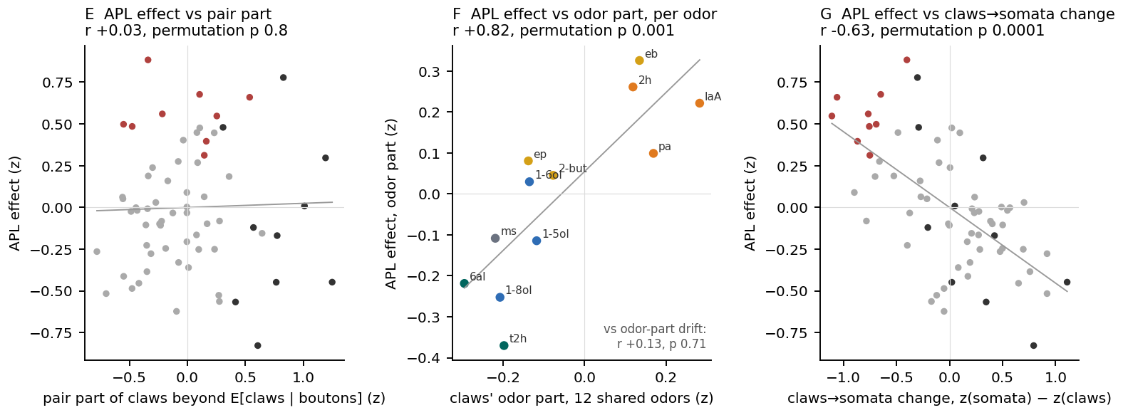
Pair part: no effect. Odor part: held down by APL. Its drift: untouched.
“And the other two predictions?”
E · prediction 1, pair part: r +0.03
F · prediction 3, odor part: r +0.82
G · prediction 2, claws → somata: r −0.63
The 16 largest-pair-part pairs change no more than the rest. Not APL’s.
Largest rise for the highest claw odor part (eb, 2h, IaA), a fall for t2h, 1-8ol, 6al. Versus the drift: r +0.13, p 0.71.
The step is undone in proportion to its size.
Data: Yang Zheng · KC somata, APL intact (TNT3c) vs silenced (TNT) · 12 of our 17 odors, 66 pairs
Where the odor code is built · 29
Section 8 of 9 · APL data · Yang Zheng
Notes:
F uses the odor part re-estimated on the 12 shared odors (r +0.82, p 0.001); against the Figure 7 odor part estimated on all 17 odors it is +0.45 to +0.48 (p 0.05–0.07). E: linear fits r 0.03–0.07, p 0.6–0.8.

Slide 30
Linear and quadratic fits give the same three answers
“Would this survive a different fit?”
APL effect vs … (66 pairs; permutation p) | linear fits | quadratic fits
claws → somata change | r −0.60, p 0.0001 | — (no fit involved)
somata beyond E[somata | claws], holding the pair part constant | r −0.54, p 0.0001 | r −0.43, p 0.02
pair part, holding the soma step constant | r 0.20, p 0.12 | r 0.25, p 0.09
odor part (12 shared odors) | r 0.63, p 0.003 | r 0.67, p 0.004
odor-part drift | r 0.11, p 0.70 | r 0.10, p 0.73
fraction of the soma step left after silencing | 0.56 | 0.54
Bouton and claw similarity are related by a convex curve, so every step was repeated with a quadratic term. The APL effect itself is not curved (quadratic term −0.05).
Data: Yang Zheng · KC somata, APL intact (TNT3c) vs silenced (TNT) · 12 of our 17 odors, 66 pairs
Where the odor code is built · 30
Section 8 of 9 · APL data · Yang Zheng
Notes:
Table values use the static reference tables; the figure panels use the time series; the two agree at r ≥ 0.99. One row to know about: part of claws beyond E[claws | boutons] moves with silencing independently of the soma step (r 0.33 linear, 0.38 quadratic), most likely through its odor part.

Slide 31
From “APL decorrelates KC responses” to a claim with a which, a where and an alongside-what
“What does Yang’s experiment add?”
Which pairs
Which odors
Which step
Alongside what
The acetate–ester pairs: they arrive overlapped and are separated at the somata.
High claw odor part (eb, 2h, IaA); not the drift. Why APL tracks a claw-level quantity is open; perhaps such odors recruit more KCs, hence more feedback.
Claws → somata, the readout into spikes. Not the wiring-set pair part.
A spike threshold that accounts for the other half of the step.
What would make it a paper claim
Not in the paper yet
Per-fly matrices from the same experiment, for confidence intervals. Single ROIs: ester-selective somata should regain small acetate responses without APL.
APL is two Discussion sentences from the literature. No statistic in the paper depends on this comparison.
Data: Yang Zheng · KC somata, APL intact (TNT3c) vs silenced (TNT) · 12 of our 17 odors, 66 pairs
Where the odor code is built · 31
Section 8 of 9 · APL data · Yang Zheng
Notes:
Limits now: condition means (no across-fly CIs); 12 of 17 odors; cosine vs r (ranks alike, scales differ); part of the claw leftover still moves with silencing (r 0.33–0.38).

Slide 32
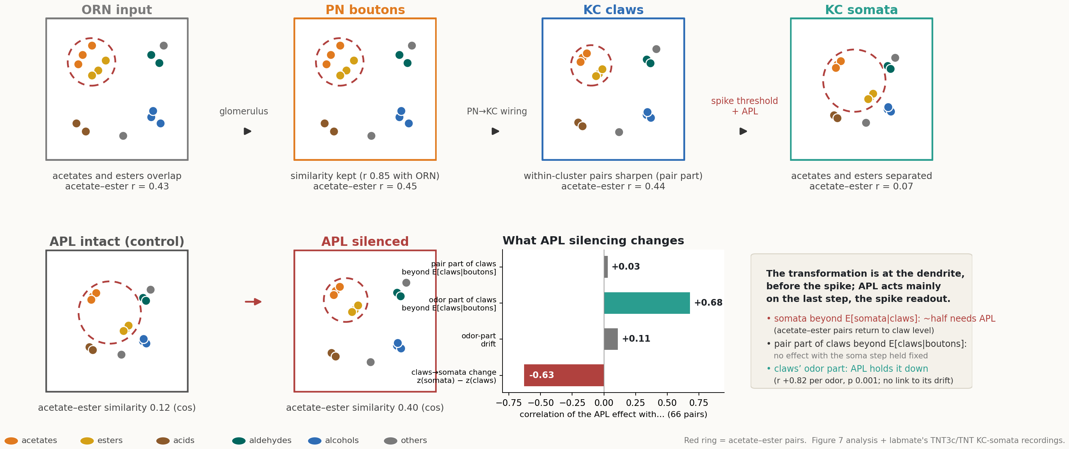
The code is made at the dendrite; APL acts at the readout
THE CLAIM
Part of the KC odor code is already in place at the claws, before any spike, and shows no detectable APL effect. The acetate–ester separation is made at the readout: about half of it needs APL, and the rest is consistent with a threshold.
Where the odor code is built · 32
Section 9 of 9 · So what
Notes:
Top row: odor positions at each stage (red ring = acetate–ester pairs); the ring stays tight from ORN input through the claws and opens at the somata. Bottom row: with APL intact the acetates and esters are apart (0.12, cosine); silenced, they come back together (0.40). Bars: correlation of the APL effect with each quantity across the 66 pairs.

Slide 33
Three experiments, and the two assumptions the claim leans on
“What would you do next, and what could still be wrong?”
Per-fly APL matrices
Single-cell APL test
Time-matched references
The same experiment with per-fly matrices gives confidence intervals; a split-half across her flies turns the APL assignment into a result.
Ester-selective somata should regain small acetate responses when APL is silenced. A yes confirms the threshold-plus-inhibition reading.
Somata and ORN imaged in the same windows as the claws would remove the “static references from other flies” caveat.
Assumption 1 · the claw mask
Assumption 2 · mechanism
Claw ROIs are assumed to exclude somata-level signal and to weight glomeruli like GH146 boutons. Unconfirmed; the “KC-level signal in claw calcium” reading depends on it.
The data localize and time the transformation. They do not distinguish structured calyx inhibition from non-uniform PN–KC weights or centrifugal input.
Where the odor code is built · 33
Section 9 of 9 · So what
Notes:
Other limits: small samples in different animals (4 claw flies, 5 bouton flies; per-pair tests have no power); 17 odors (one odor can move a per-window correlation by 0.1–0.2, jackknife ranges reported); post-offset changes are partly kinetic and not leaned on.

Slide 34
Everything here can be recomputed from the report, the explainer page and the code
TO CHECK THE WORK
The report
The explainer page and dashboards
Code and APL comparison
rdm_timeseries_analysis_report.html: ten sections, every table and figure, methods, caveats, reproducibility. Outputs in outputs/results/, one folder per section.
Python in Figure-07/code/ (logs in code/logs/). APL comparison: labmate_apl_matrices.py, apl_quadratic_check.py, apl_odor_level_check.py; outputs in 7_pair_movers/apl_labmate_matrices/.
rdm_timeseries_explainers.html recomputes the main sections in the browser from the per-fly data, with toys and port checks. The RDM Explorer and decomposition dashboard show any time bin.
An independent from-scratch recomputation matched every headline pair-movers number to 3 decimals. Every JavaScript port in the explainer page was checked against the Python outputs. The per-fly data are not in this deck; ask.
Where the odor code is built · 34
Section 9 of 9 · So what
Notes:
The data stay local on request; the report, explainer page and dashboards are files that can be shared directly. Comments on specific slides are welcome in the deck itself.

Slide 35
“You could say…” — one objection per slide, with what was done about it
APPENDIX
A1 · the 136 pairs are not independent
A2 · noise looks like change
A3 · one odor could carry an odor-level result
A4 · the compression slope is partly noise
A5 · Pearson r hides amplitude
A6 · the odor / pair split is a curve fit; noise alone gives an odor part
A7 · the split depends on the scale (r, Fisher z, rank)
A8 · a noisy odor looks like an odor-part shift
A9 · the pair part is not “wiring”
A10 · the references are from other flies and windows
A11 · the claw–bouton relation is curved, so a linear residual is wrong
A12 · the APL comparison is averaged matrices, 12 odors, cosine vs r
B1–B2: the vector identity behind the odor / pair split, with its numeric check, for anyone who wants the algebra.
Where the odor code is built · 35
Appendix · you could say…
Notes:
Use these in Q&A, or walk through them if the room wants it. Every slide has the same three parts: the toy, what was done, what it showed.

Slide 36
Correct: each odor sits in 16 pairs. So p-values come from shuffling odor labels, not pairs
“Your 136 pairs are not 136 independent measurements.”
Toy. Five odors, ten pairs. Odor C sits in four of them, so a wrong value for C moves four cells at once. Shuffle the odor labels (right: the same matrix with its rows and columns relabelled) and recompute: that null keeps the sharing and breaks only the match being tested.
What we did
Odor-label permutation for every p-value on pair-level correlations (1,000–10,000 relabelings; Freedman–Lane for partial coefficients); leave-one-odor-out jackknife for standard errors. Effective n is about 65 pairs, not 136.
A
B
C
D
E
A
B
C
D
E
A
A
B
B
What it showed
C
C
Split-half replication of the bouton − claw difference p ≤ 0.0005 in every window; somata coefficient p 0.0001; APL tests all under the same null. Nothing was ever reported with a pair-counted p.
D
D
E
E
Where the odor code is built · 36
Appendix · you could say…
Notes:
Freedman–Lane: residuals of the reduced model permuted by odor label, the same permutations for every split. The block test for the ester × aldehyde block compares its mean with every block of two disjoint odor triples (123,760).

Slide 37
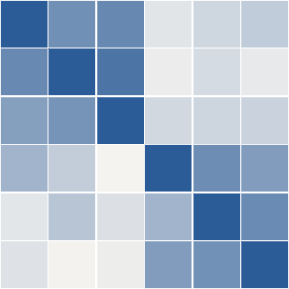
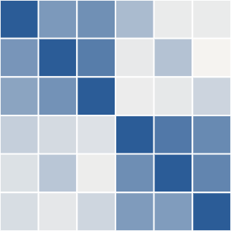
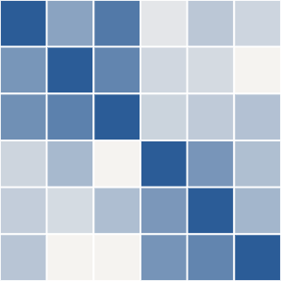
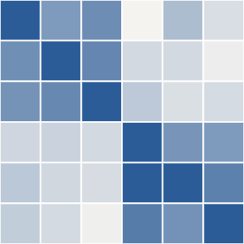
Right. Change is only counted after dividing by how well two copies of the same thing agree
“Two noisy matrices never agree perfectly, so “stable” and “changed” both look like r below 1.”
Toy. Two noisy copies of the same matrix at time 1, two at time 2. Copies of the same thing agree at r ≈ 0.8 (the ceiling). Time 1 vs time 2 also gives ≈ 0.8, so the corrected stability is 0.8 ÷ 0.8 = 1: nothing changed.
What we did
Noise-corrected stability = cross-time split-half r ÷ geometric mean of the same-time split-half r’s. Every “stable” or “drifts” statement uses it. Reliability itself is tracked per frame beside the similarity.
vs
What it showed
Pair part 0.91–0.98 across windows (stable). Odor part early × late 0.50 (drifts). Same-fly claw-soma agreement 0.86 against a ceiling of 0.83–0.92 (at the ceiling).
Where the odor code is built · 37
Appendix · you could say…
Notes:
Open question we flag ourselves: whether the ratio is unbiased for true stability or inflated near 1. The windows share boundary frames; half-open windows give the same picture.

Slide 38
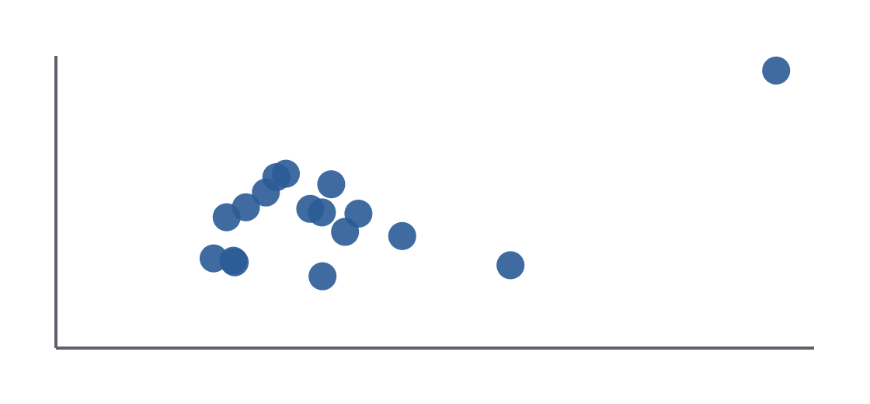
Yes. Every odor-level number is reported with the range you get by dropping each odor in turn
“With 17 odors, one odor can make or break an odor-level correlation.”
Toy. Sixteen odors with unrelated values in two measurements, plus one odor extreme in both: r 0.60 with it, −0.01 without it. Leave-one-out range −0.01 to 0.70.
What we did
Leave-one-odor-out ranges for every odor-level coefficient; the most influential odor is named (linalool, +0.78 early). Odor-level p-values come from relabelling odors.
What it showed
m. 2
Somata coefficient: 0.34–0.52 across leave-one-out (point estimate 0.48). The APL odor-part correlation (+0.82) is on 12 odors and is stated as exploratory for exactly this reason.
odor value, measurement 1
Where the odor code is built · 38
Appendix · you could say…
Notes:
What no method fixes: 17 odors is 17 odors; odor-level results are called odor-level and not more.

Slide 39
Partly, yes: about a third of it. Corrected, the slope is 0.85, and no pair-level result moves
“Your “compression” slope of 0.8 is partly just noise in the boutons.”
Observed r = true r × √(reliability₁ × reliability₂). Same-odor single-trial reliability: 0.71 boutons, 0.64 claws. Dividing out the noise:
What we did
Standard attenuation correction on the compression slope, by window (raw 0.72 / 0.81 / 0.75 / 0.55 → 0.77 / 0.87 / 0.86 / 0.59). The pair pattern was recomputed with and without it.
slope, raw
0.77
slope, corrected
0.85
pair pattern, raw vs corrected
r 0.99
What it showed
If a compression number goes in the paper, 0.85 is the defensible true value and 0.77–0.80 the observed one. The pair pattern is unchanged (r 0.99), so nothing downstream changes.
Where the odor code is built · 39
Appendix · you could say…
Notes:
The correction assumes independent additive trial noise. Its error bars are an open question we list; the regressor noise in the fits is handled separately by the split-fly instrument (slide 15).

Slide 40
By design. Pattern and strength are measured separately, and the strength does not explain the odor part
“Pearson r throws away how strongly each odor responds.”
What r keeps and drops. r centres and scales each odor’s pattern across cells, then takes the dot product: it keeps which cells respond and drops how much and any offset shared by all cells. Two odors with the same pattern at half the amplitude have r = 1.
What we did
Level and geometry tracked separately: between-odor r ÷ same-odor r for the level (the shared decorrelation), rank geometry for the shape. Claw drive read off the heat-raster PDF and compared with the odor values.
That is the quantity the hypothesis is about (which odors share cells), and the one Figure 6 used.
What it showed
Claws are normalized across odors; the odor values aᵢ do not track claw drive. The decorrelation changes the level only; which pairs are similar survives it (rank geometry).
Where the odor code is built · 40
Appendix · you could say…
Notes:
The 2D vector picture (slide 20) shows why: amplitude is the length of the arrow, and r only sees its direction.

Slide 41
Pure noise gives an odor part of about 12 %. The claws’ 32–40 % is far above it, and the values reproduce in other flies
“Seventeen free parameters will always explain something. Your “odor part” could be noise.”
Toy. Fit the odor-part model to 3,000 matrices of pure noise. Share of variance it “explains”: mean 11.8 %, 95th percentile 18.6 % (about 17 parameters ÷ 136 values). The 17 odor values from two independent noise matrices correlate at r +0.01 ± 0.25.
What we did
A share is never read on its own. Both parts were checked across fly-disjoint halves (30 splits) and every inference uses odor-label permutation.
noise, mean
12 %
noise, 95th pct
19 %
What it showed
claws, observed
32–40 %
The whole leftover pattern reproduces at r 0.56–0.60; the pair part at ≈ 0.6 (p 0.002); the odor part’s early × late stability is 0.50, which is why its change is reported as a drift.
Where the odor code is built · 41
Appendix · you could say…
Notes:
The algebra itself is sound: the fit is a projection, so odor-part SS + pair-part SS = total SS exactly and the two parts are uncorrelated by construction (decomposition toy A).

Slide 42
A slightly different one. Every headline moves by at most 0.07 across r, Fisher z, ranks and quadratic fits
“Run the same split on Fisher z or on ranks and you will get a different answer.”
scale / fit (0.5–3 s) | split-half | vs somata | pair part | odor part
Pearson r | 0.57 | 0.59 | 0.69 | 0.54
Fisher z | 0.56 | 0.59 | 0.71 | 0.56
ranks | 0.56 | 0.55 | 0.63 | 0.49
quadratic | 0.52 | 0.47 | 0.62 | 0.51
What we did
Recomputed the headline correlations on Fisher z, ranks and 1 − r, and with a quadratic fit of claws on boutons.
What it showed
Toy C on the decomposition canvas: a purely multiplicative odor effect (rᵢⱼ = cᵢ·cⱼ) puts 6 % of its variance in the pair part on r and 1 % on log r; the share depends on the scale a little.
Within 0.07 everywhere; 10, 9 and 7 of the 11 top movers survive Fisher z, ranks and quadratic. Within that range the scale does not change what the parts say.
Where the odor code is built · 42
Appendix · you could say…
Notes:
Columns: split-half r of the claw leftovers; that pattern vs somata; pair part vs somata; odor part vs the model difference.

Slide 43
True, and that is why the drift had to replicate in independent flies while reliability was tracked
“An odor that is just measured less reliably will look like it “drifted”.”
Toy. Same two-cluster geometry, but one odor measured with reliability 0.3 instead of 0.8. Observed r = true r × √(relᵢ relⱼ), so its whole row shrinks. The fit reads that as an odor value of −0.09 where the truth is +0.02. Nothing moved.
What we did
Same-odor trial reliability tracked per frame beside the between-odor r; a reliability control on the odor values; the drift required to replicate across fly halves and in a separate fly.
Pearson r cannot tell “moved away from everyone” from “got noisier” on its own.
What it showed
Between-odor r falls while reliability holds (Figure 7D). The drift replicates across fly halves (r 0.46, p 0.001) and in the same-fly recording (r 0.73). A reliability artefact would not point the same way in independent animals.
Where the odor code is built · 43
Appendix · you could say…
Notes:
This is the one place the appendix B identity does not save you: reliability enters multiplicatively, not additively, so it leaks into both parts. The disattenuation on slide A4 is the same effect on the slope.

Slide 44
Agreed, which is why it was renamed “pair part” and tested against specific structures
“You call the pair part “wiring”. It is just everything your odor model cannot fit.”
Toy. Two clusters, within-cluster r 0.6, between 0.1. No pair is special, yet the pattern is not “one value per odor”: odor part 1 %, pair part 99 %. Cluster blocks live in the pair part.
What we did
The pair part was never read as “pair-specific wiring” on its own. It was tested against the somata’s clusters, against the ester × aldehyde block by its own permutation, and against both wiring models.
A
B
C
D
E
A
B
What it showed
C
Within − between somata-cluster pull +0.49 SD (p 0.0003); both wiring models predict it partly (r 0.23–0.37); the block is pushed apart as the connectome predicts (p 0.009). “Stationary pair part” means the whole non-additive structure is stationary, clusters included.
D
E
Where the odor code is built · 44
Appendix · you could say…
Notes:
A cluster-level change shows up in both parts (toy D: one cluster tightening by +0.25 splits 62 % odor part, 38 % pair part). The parts are a projection, not a sorting into mechanisms.

Slide 45
They do. Two checks: swap the reference, and one fly imaged at both stages
“Your somata and ORN references come from other flies, other days, other windows.”
 | 18-fly somata reference | 4-fly reference
somata coefficient | +0.48 (p 0.0001) | +0.40 (p 0.0002)
pair part vs somata | 0.65–0.71 | 0.59–0.65
cluster pull (SD) | +0.49 | +0.41
S7B somata ARI rises | 4 of 4 flies | 4 of 4 flies
What we did
Every somata-dependent result rerun with the 4-fly reference (kc_remy) instead of the 18-fly one (kc_remy_combo). One fly imaged at claws and somata on the same trials.
What it showed
Same conclusions with either reference. In the one fly, the somata are stationary (r 0.87–0.91 with the stored reference) and the claws → somata step is the same at every moment.
The two reference matrices correlate at r 0.97. Effects 15–20 % smaller with the 4-fly one; no conclusion changes.
Where the odor code is built · 45
Appendix · you could say…
Notes:
Still open: time-matched references for ORN; whether the smaller 4-fly effects reflect a noisier average or older flies. With the 4-fly reference the hemibrain model keeps some weight in the joint model (+0.19, p 0.04) and the quadratic check is weaker (+0.27, p 0.02).

Slide 46
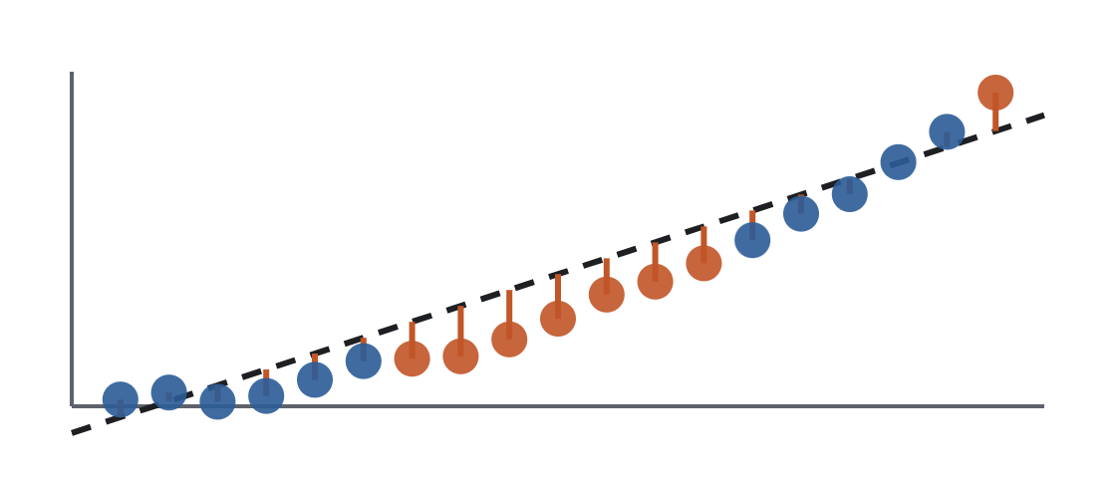
It is slightly convex, so every result was repeated with a quadratic term; the picture holds
“The claw-vs-bouton relation is curved. A straight-line residual will mislabel pairs.”
Toy. A convex relation fitted with a straight line leaves a smooth residual: weak and strong pairs above the line, middling pairs below, with nothing pair-specific going on.
What we did
Quadratic F 27.8 (p < 0.001), cubic n.s. Every fit repeated with a quadratic term, including the APL comparison; mixed-space artefacts checked by running each test in one space.
What it showed
claw
Headline numbers lower by up to 0.12 with the quadratic; 7 of the 11 top movers kept; the APL answers identical under both fits (slide 30). One claw effect that first looked “quadratic only” turned out to hold under both fits in one space (r 0.33 / 0.38).
bouton similarity
Where the odor code is built · 46
Appendix · you could say…
Notes:
The linear fit is chosen deliberately: slope = compression, residual in interpretable units. The convexity is the signature of a sparsening nonlinearity, which is itself consistent with the threshold reading.

Slide 47
All true, which is why it is exploratory and not in the paper. Here is what would make it a result
“The APL comparison is two averaged matrices, 12 odors, cosine against Pearson.”
What is averaged away. Yang’s matrices are condition means, so there are no across-fly intervals. Cosine and r rank pairs alike but sit on different scales, so “claw level” is approximate. 12 shared odors give 66 pairs instead of 136.
What we did
Mapped Yang’s 16 odors to our 12 shared ones; compared with the Figure 7 references and components; ran every correlation as a permutation test; repeated with quadratic fits; checked each test in one space.
What survives anyway. Yang’s intact somata match ours at r 0.93; every test uses odor-label permutation; the three answers hold under linear and quadratic fits.
What it showed
A null on the pair part, a +0.82 on the odor part, a −0.60 on the claws → somata step. Per-fly matrices from the same experiment, and a split-half across her flies, would turn the assignment into a result.
Where the odor code is built · 47
Appendix · you could say…
Notes:
Data: Yang Zheng, dated 2026-10-22. Files: labmate_apl_matrices.py, apl_quadratic_check.py, apl_odor_level_check.py, apl_spaces_check.py. No statistic in the paper depends on this comparison.

Slide 49
Every equality holds to floating-point precision on a 17-odor toy
APPENDIX B · NUMERIC CHECK
claim | check | result
four-term identity | max over 136 pairs of |rᵢⱼ − (|m|² + ⟨dᵢ,m⟩ + ⟨dⱼ,m⟩ + ⟨dᵢ,dⱼ⟩)| | 2.8 × 10⁻¹⁶
pair matrix has zero row sums | max row sum of DDᵀ | 3.3 × 10⁻¹⁶
fitted aᵢ vs ⟨dᵢ, m⟩ | correlation; slope | 1.000; 1.1333 = 17/15
pair part vs ⟨dᵢ, dⱼ⟩ | correlation | 0.993
pair part vs ⟨dᵢ, dⱼ⟩ with the leak term | max absolute difference | 3.2 × 10⁻¹⁶
residual odor values vs (1/σᶜ)⟨dᵢᶜ, mᶜ⟩ − (β/σᵇ)⟨dᵢᵇ, mᵇ⟩ | correlation; slope | 1.000; 1.1333
What it settles
What it does not settle
The two parts are well-defined quantities in the response vectors: the odor part is how far each odor’s pattern leans toward the panel’s average pattern; the pair part is what two patterns share beyond that.
m is the average of the 17 odors delivered (panel-relative); r discards amplitude; reliability enters multiplicatively and leaks into both parts. Slides A3, A5 and A8 are the answers to those.
Where the odor code is built · 49
Appendix · you could say…
Notes:
Synthetic panel 17 odors × 400 ROIs, shared component plus independent noise, seed 7, run through the analysis code’s own off-diagonal least-squares fit (make_decomposition_toys.py).

